Slide 1
Fysiologisk og biomekanisk modellering
Compartmental modelling of the cardiovascular system
Bram Smith

Slide 2
Overview
Modelling the cardiovascular system (CVS)
Purpose:
  Intended applications
Conceptualisation:
  The physiology
  Design considerations
Realisation:
  CVS model design
Solution
Validation
Exercise: Build a model of the left ventricle.

Slide 3
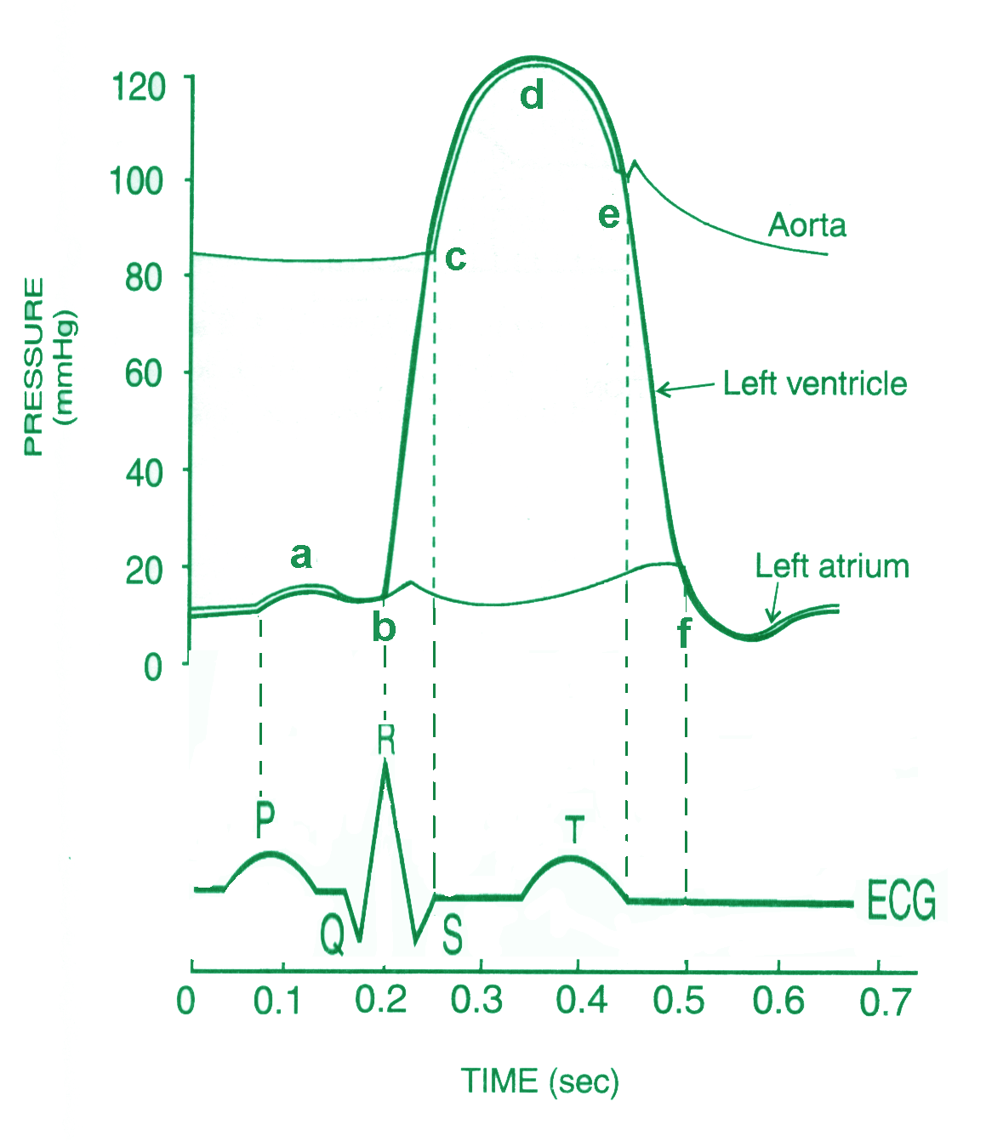
Intended applications
Educational
  Change model parameters and simulate the effects on hemodynamics.
Research
  Study the contributing factors to characteristic CVS dynamics.
Decision support
  Fit the model to patient specific data and use the resulting parameters to assist in diagnosis.

Slide 4
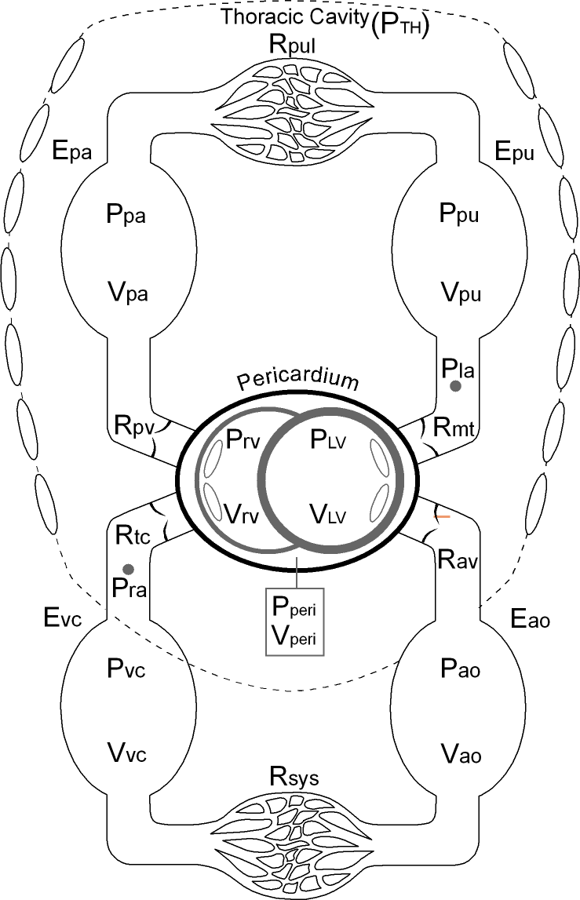
The physiology
The circulation system can be divided into:
  The pulmonary circulation
  The system circulation
  The heart
The left heart pumps blood around the body.
The right heart pumps blood through the lungs.
Pulmonary
Circulation
Heart
Systemic
Circulation

Slide 5
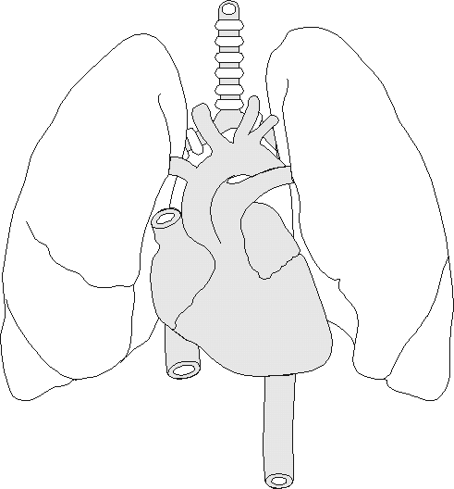
Cardiopulmonary Interaction
Respiration causes changes in the pleural pressure, which affect the heart and the pulmonary blood circulation.
Important because mechanical ventilation increases pressure in the thoracic cavity, which can limit perfusion.
Lungs
Heart

Slide 6
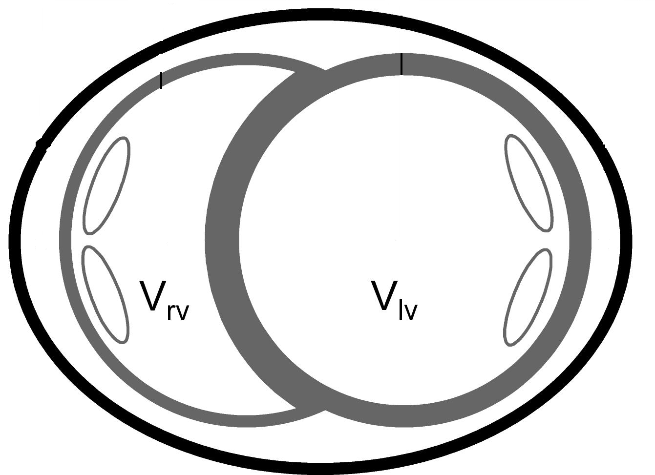
Ventricular Interaction
Ventricular interaction can occur through both:
  Series interaction through the pulmonary and systemic circulation systems.
  Direct interaction through the septum and the pericardium.
Important in diseases such as heart failure and pulmonary embolism.
Pericardium
Septum

Slide 7
CVS model design considerations
Choosing parameters and variables
  What can we measure (or at least estimate).
  What do we want to simulate (diseases, treatments, etc.)
Model complexity
  Complex enough to capture important dynamics.
  Simple enough to be identifiable.

Slide 8
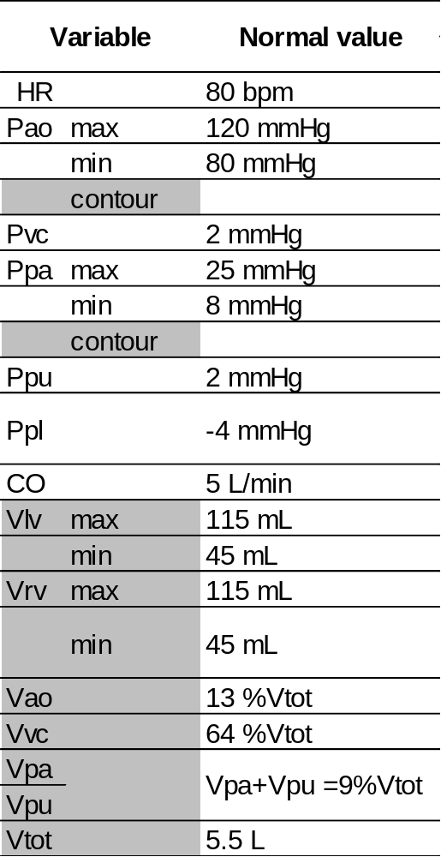
What can we measure or estimate?
Measurable:
9
Estimatable:
17

Slide 9
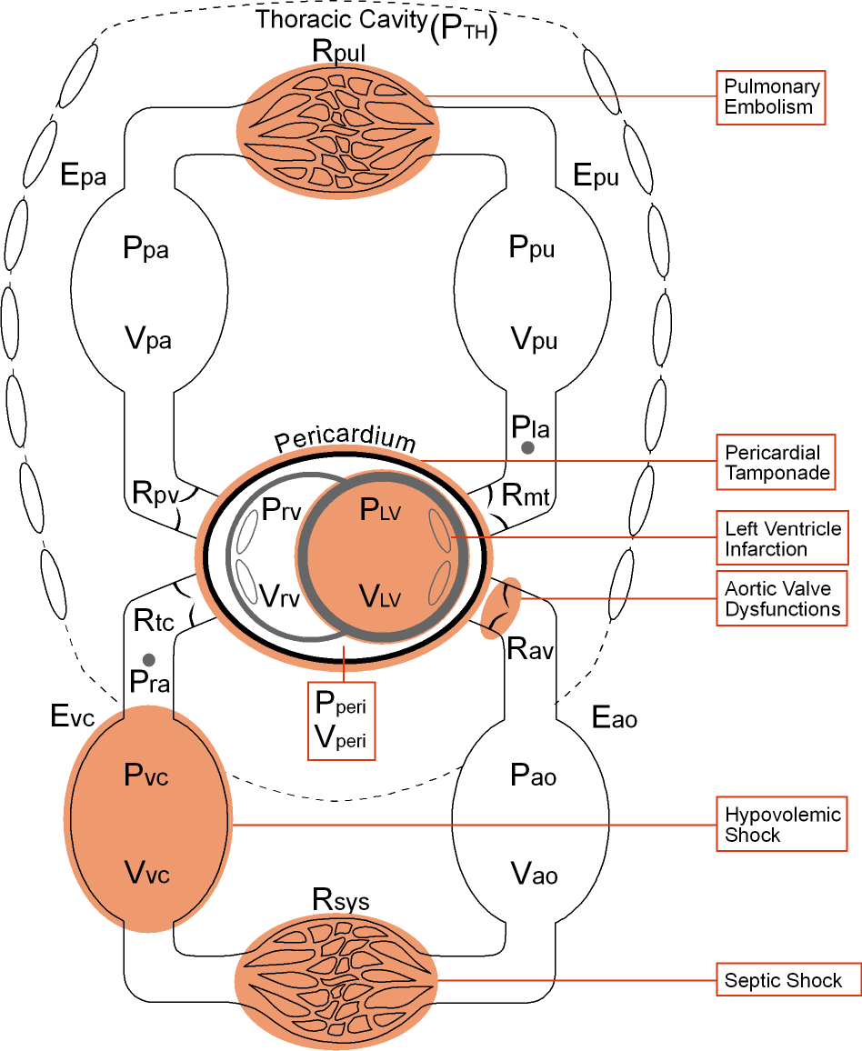
What do we want to simulate
Diseases:
  Left ventricle infarction
  Pericardial tamponade
  Aortic valve dysfunctions
  Hypovolemic shock
  Septic shock
  Pulmonary embolism
Cardiopulmonary interaction during ventilator therapy

Slide 10
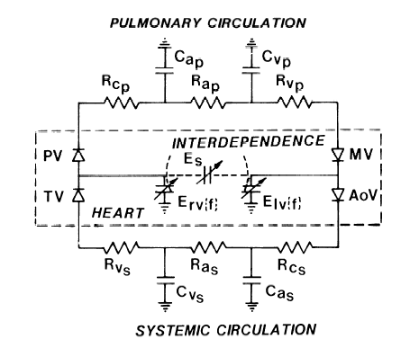
Literature review
Santamore et al. 1991
Basic 6 chamber model electrical circuit analog.
15+ parameters, 7+ state variables.

Slide 11
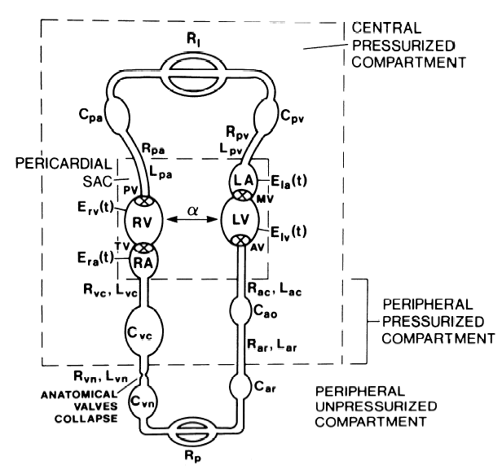
Literature review
Beyar et al. 1987
Include artia and more systemic circulation chambers.
25+ parameters, 10+ state variables

Slide 12
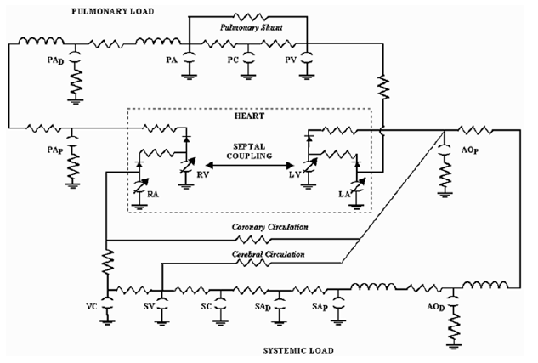
Literature review
Olansen et al. 2000
Even more detail in the systemic and pulmonary circulation systems. But are these parameters measurable.
45+ parameters, 16+ state variables.

Slide 13
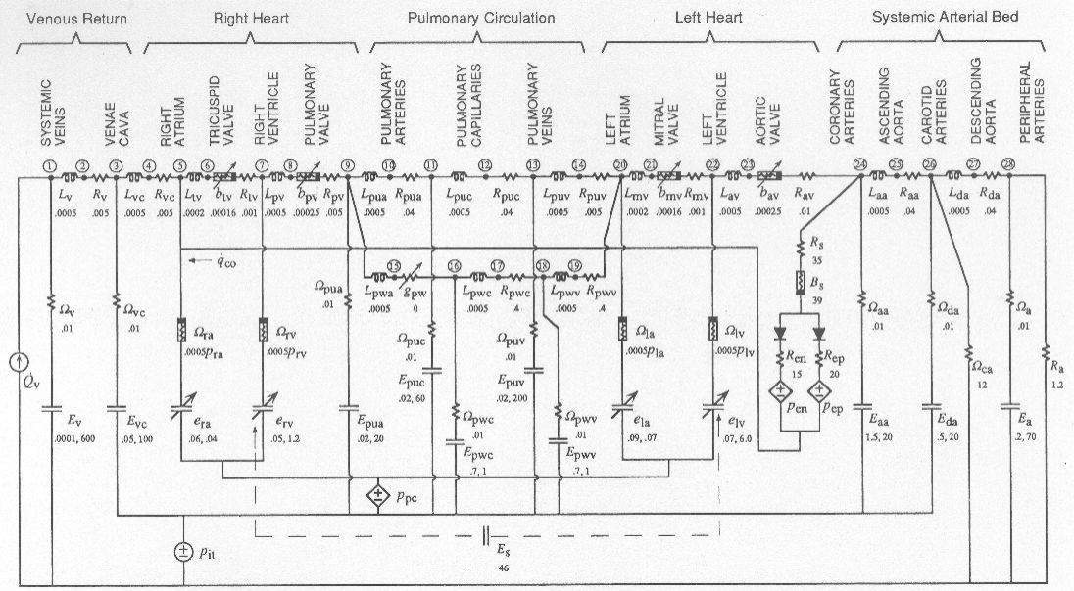
Literature review
Sun et al. 1997
How complex is too complex?
65+ parameters, 16+ state variables.

Slide 14
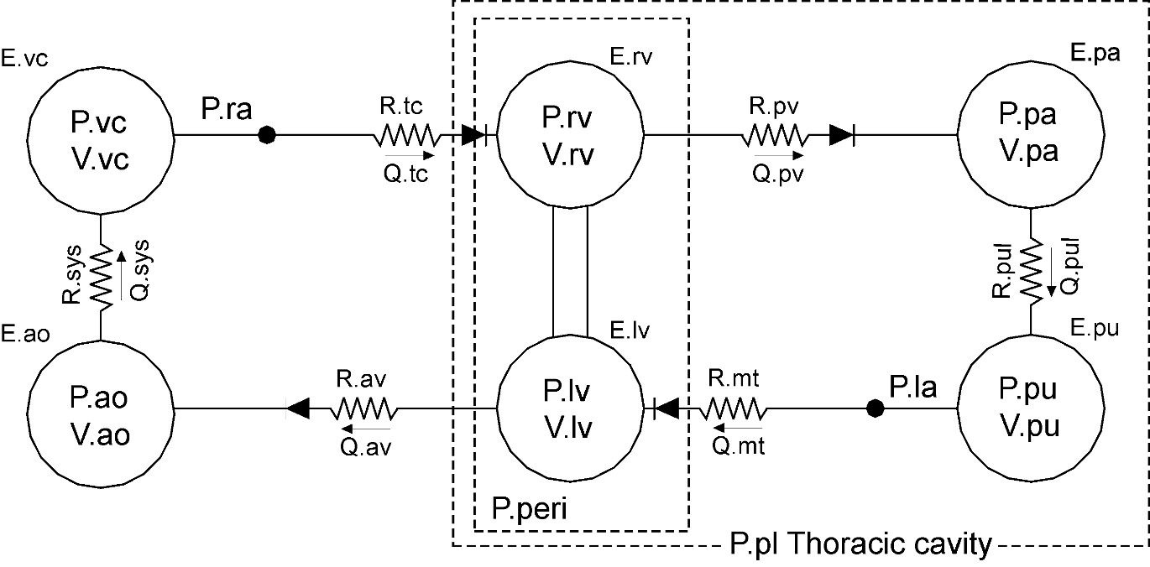
Case study
Smith et al. 2000
Systemic and pulmonary circulation systems, ventricular and cardiopulmonary interactions
38 Parameters, 6 state variables
Start by modeling one chamber.

Slide 15
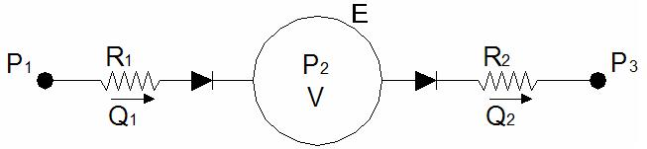
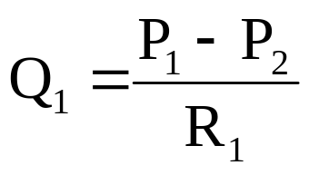

Modelling one ventricle
Start by modeling one ventricle
Constant upstream pressure
Resistance to simulate pressure drop.
Elastic chamber to simulate ventricle
Ventricle valve
Constant downstream pressure
Now how do we make it pump

Slide 16
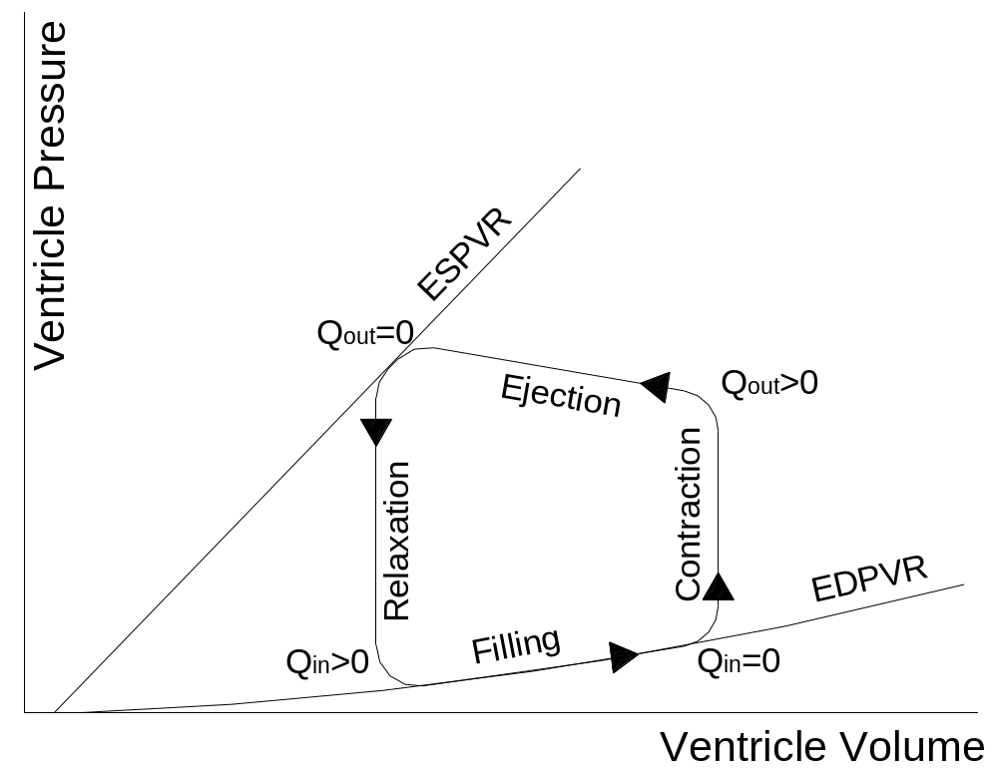


The cardiac cycle
End-systolic and end-diastolic pressure volume relationships (ESPVR & EDPVR) define the maximum and minimum ventricle elastances.

Slide 17
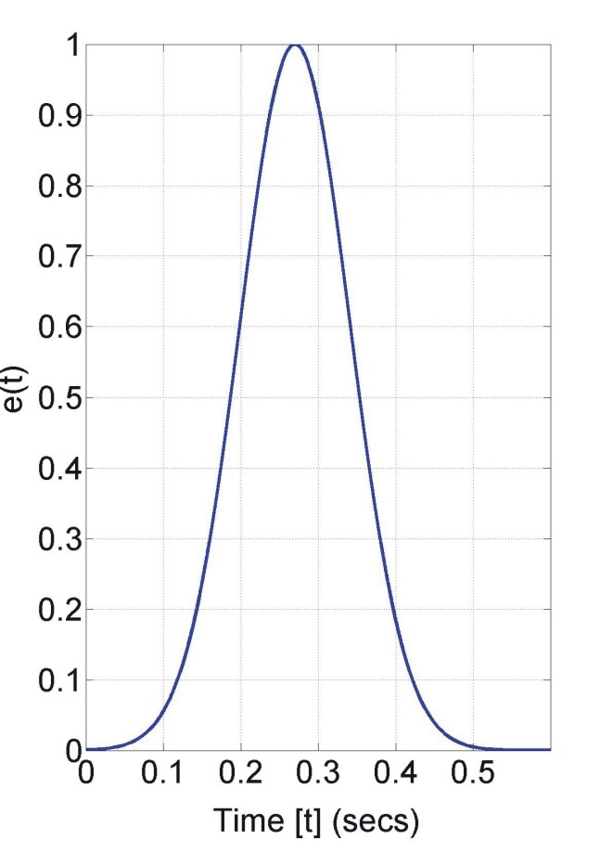

Cardiac driver function
Time varying elastance is a widely used method of simulating cardiac muscle activation (Chung et.al. (1997)).
The profile of the driver function defines the variation in elastance over the cardiac cycle.
e(t)
Time [t] (secs)
ESPVR (e(t)=1)
P
es
(V) = E
es
(V-Vd)
Q
2
=0
Ejection
Q
2
>0
Relaxation
Contraction
EDPVR (e(t)=0)
Q
>0
Filling
Q
=0
P
ed
(V) = Po(exp(
λ(
1
1
V
= Volume at zero pressure
Ventricle Volume
V
o
= Unstressed chamber volume
d

Slide 18
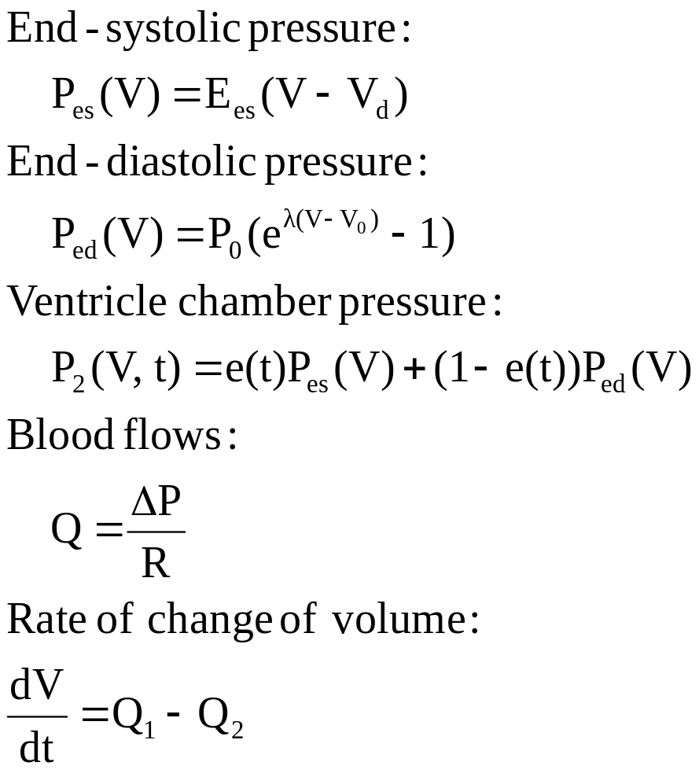
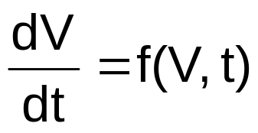
Model simulation
Solve using Matlab’s ordinary differential equation solver ode15s.

Slide 19
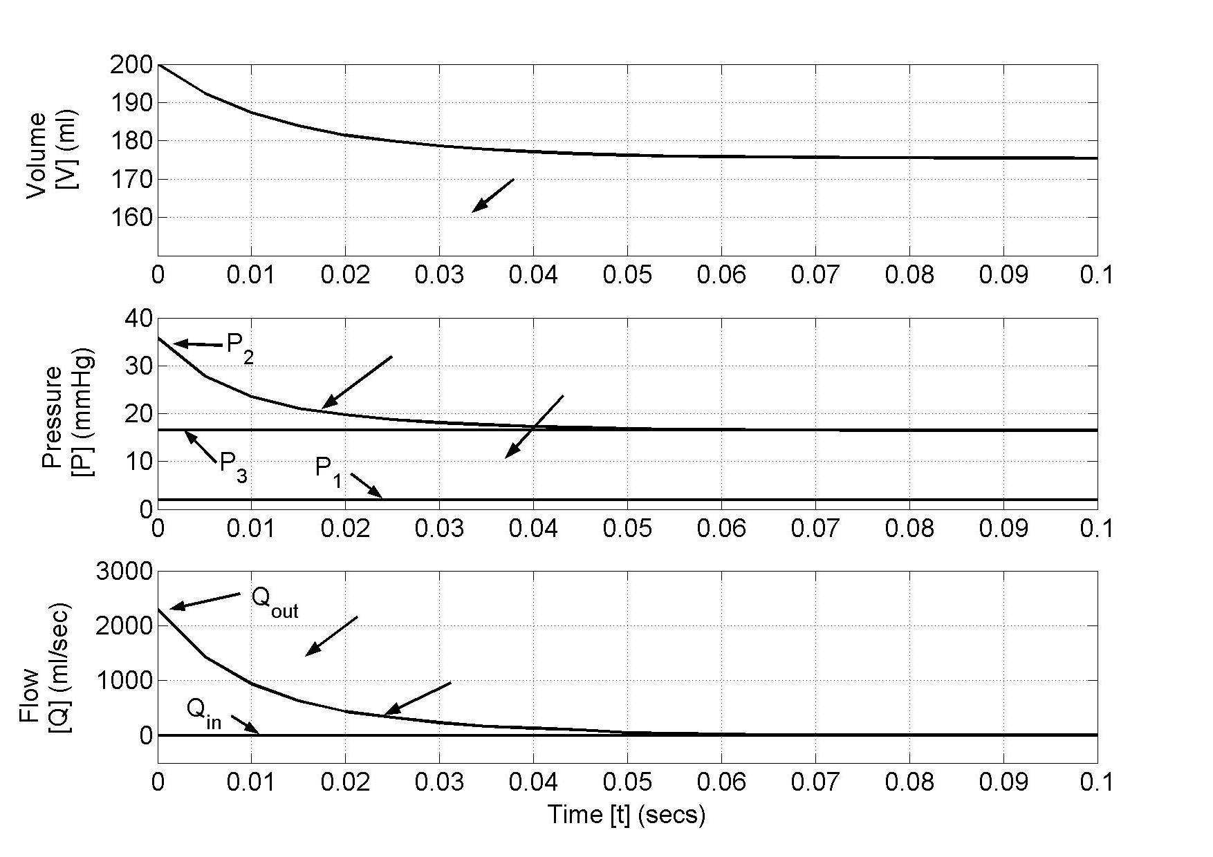
Validation
Check programming: e(t)=0

Slide 20
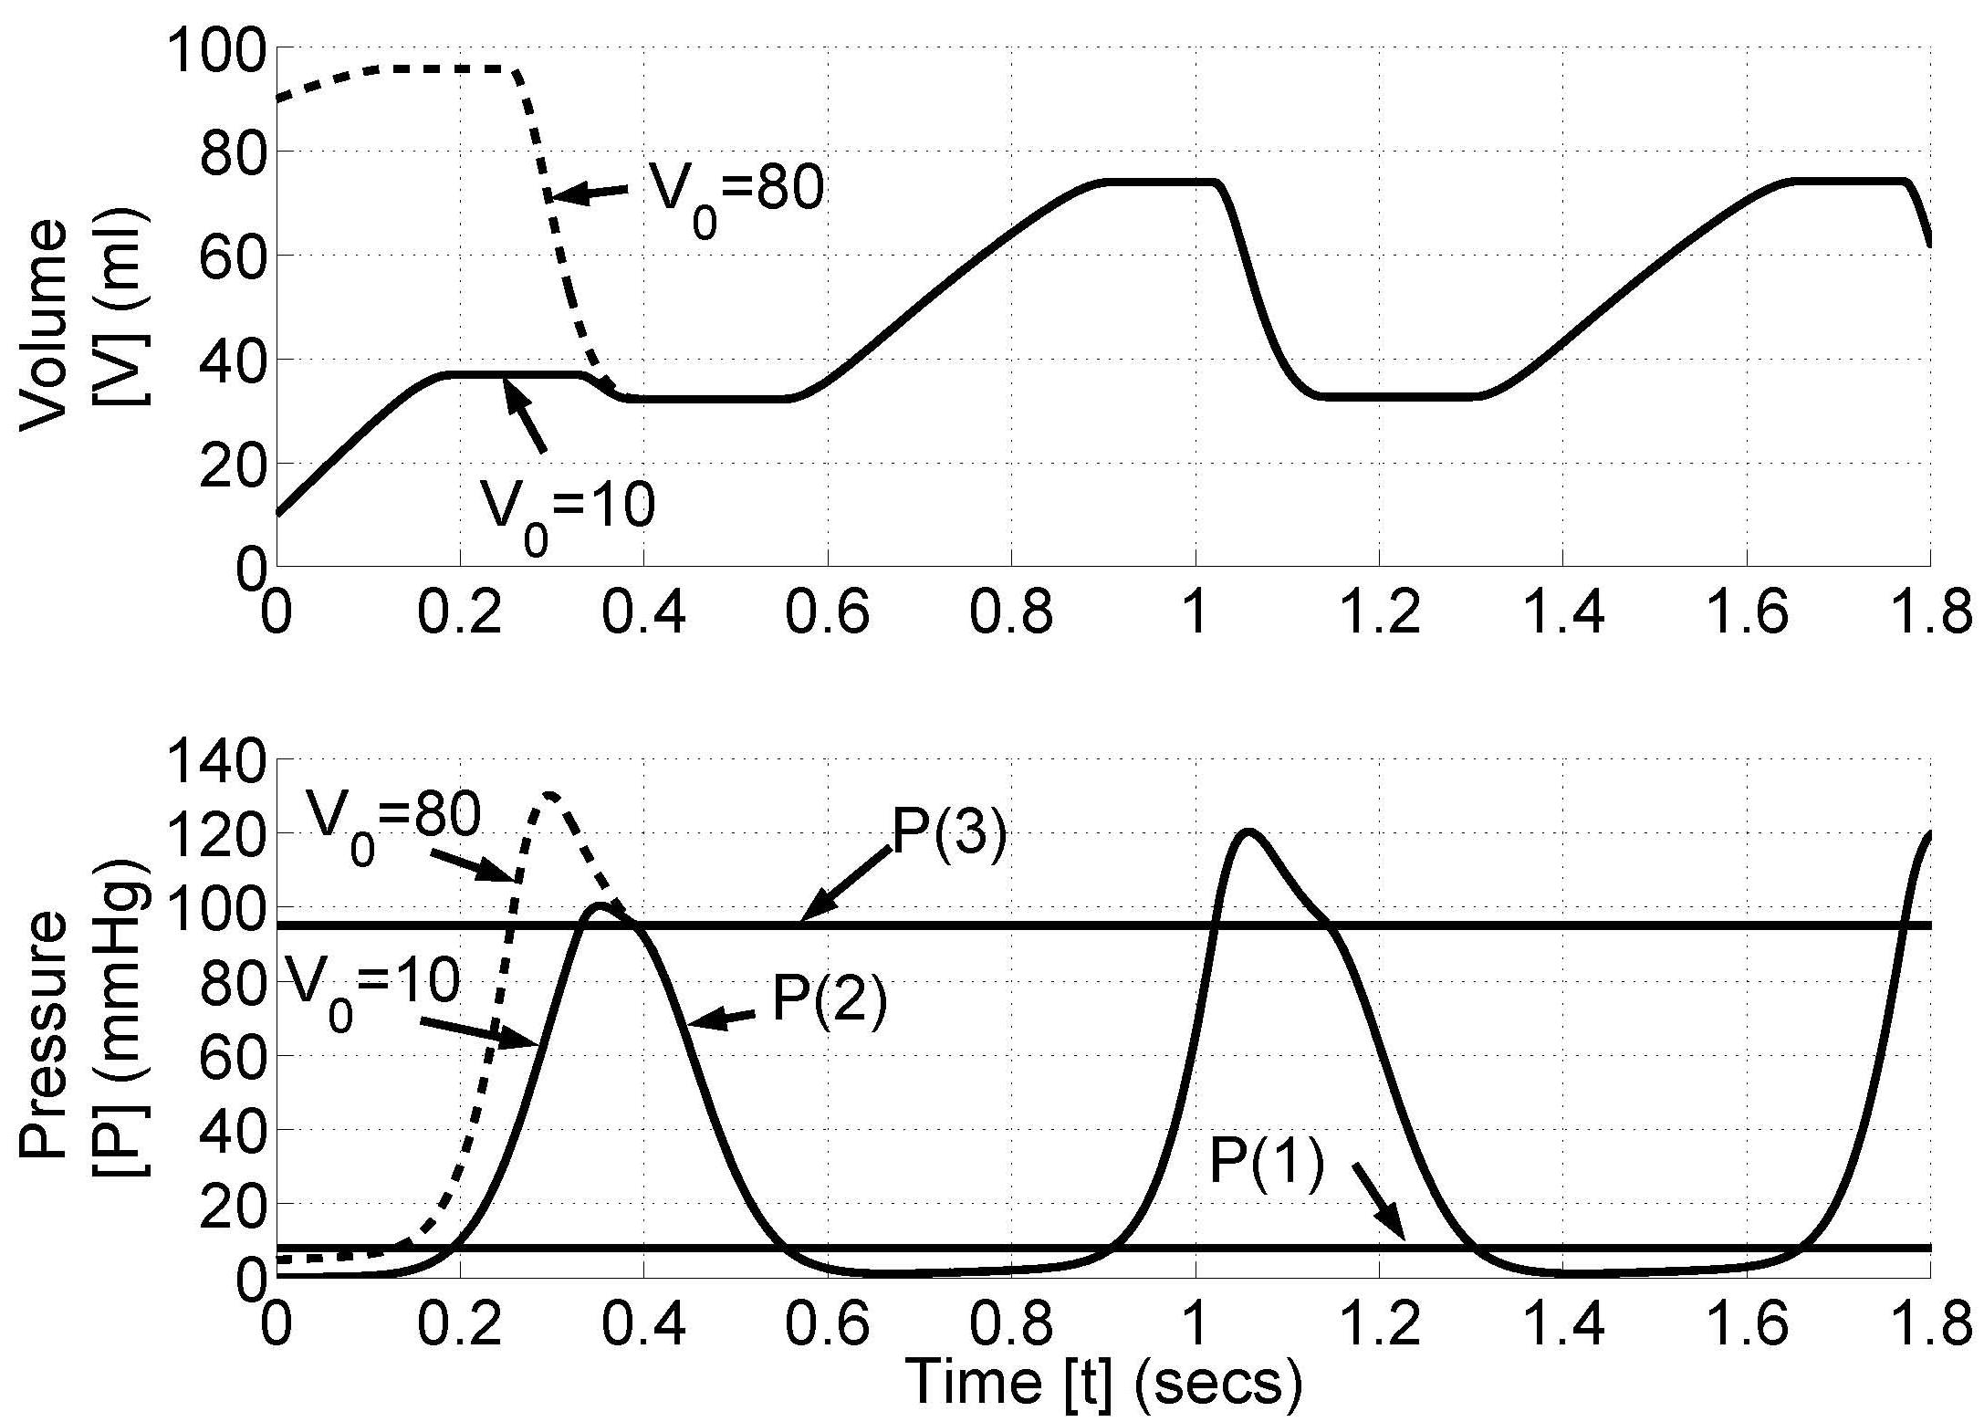
Validation
Check stability

Slide 21

The closed loop model
Chambers in the pulmonary and systemic circulation systems are assigned a linear PV relationship.
The effects of changes in pleural pressure during respiration are included to simulate cardiopulmonary interaction.
Respiration is simulated by varying P_{pl}:
  Mechanical inspiration: P_{pl} increases.
  Spontaneous expiration: P_{pl} increases.

Slide 22
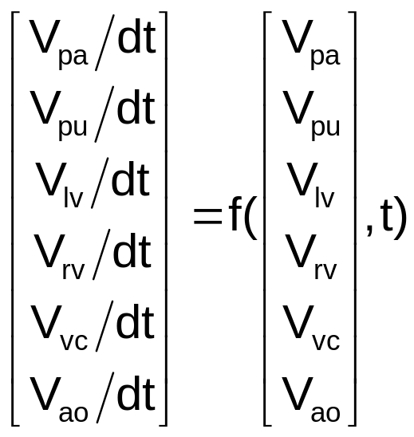
Solving the closed loop model
The ODE has 6 state variables:
  V_{pa}, V_{pu}, V_{lv}, V_{rv}, V_{vc}, V_{ao}
Solve ODE using Matlab’s ode15s function.

Slide 23
Validation
How can we validate the full closed loop model?
  Conservation of total volume
  If heart is not pumping then all pressures should become equal.
  Do the model simulations match known hemodynamics?
  Does the model accurately simulate the effects of diseases on cardiovascular system function.

Slide 24
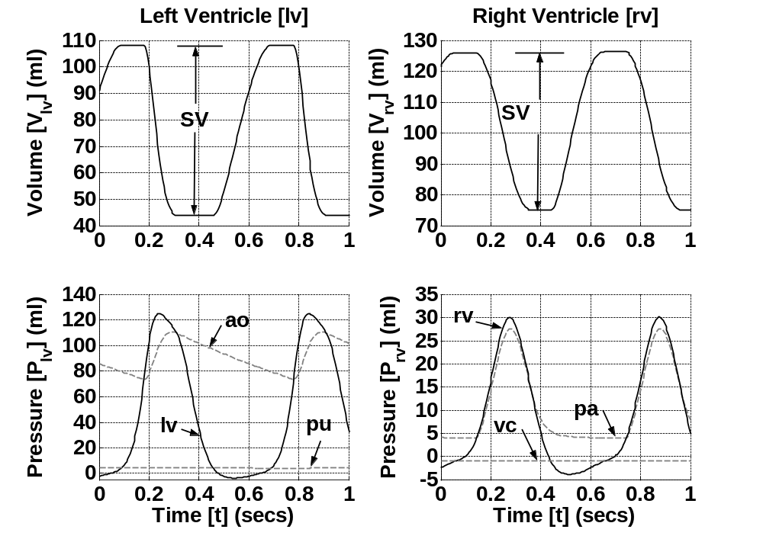
Model Validation
Initial model results capture general trends of CVS function.

Slide 25
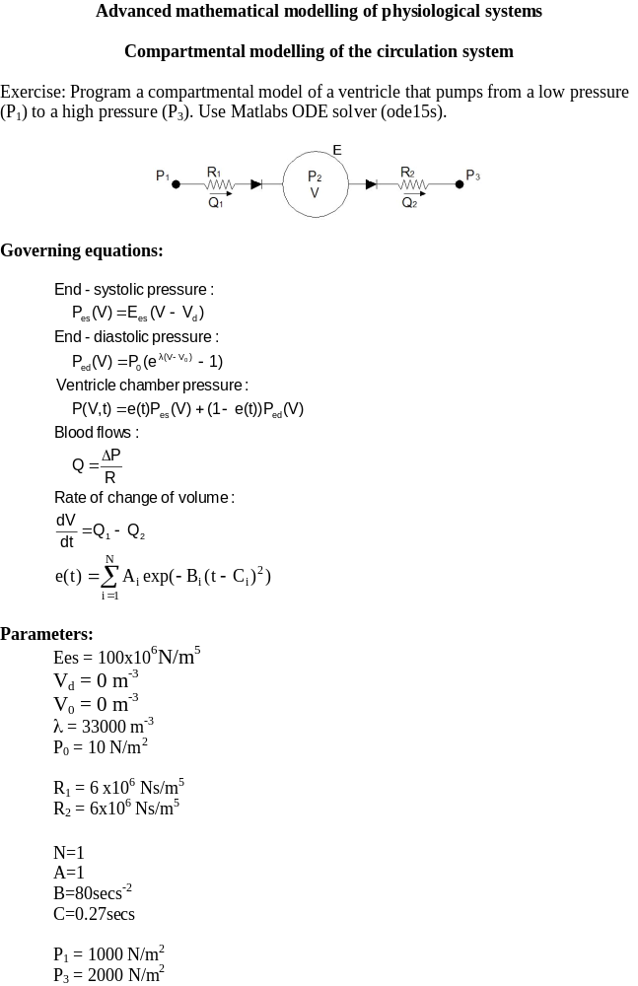
Exercise

Slide 26
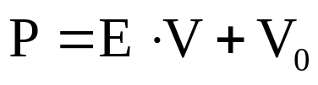
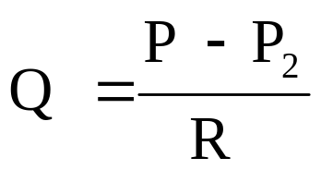
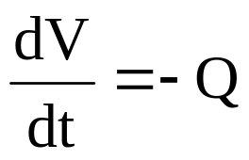
Example
2
Governing equations
Parameters
R = 20 N.s/m⁵
P₂ = 40 N/m²
E = 100 N/m⁵
V0 = 0 m³

Slide 27
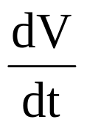
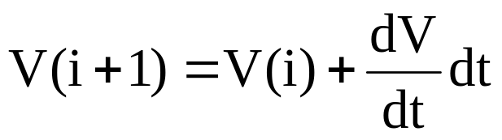
Solving example
2
Start with V(i)
Calculate:
P
Calculate V(i+1):
P₂
t(i)
t(i+2)
Repeat
t(i+1)
t(i+3)

Slide 28
Matlab implmentation
…
V(1) = Vo;
for (i=1:length(T))
%Calculate derivative
[dv]=dVfunc(T(i),V(i));
% Calculate the next volume.
if (i<length(T))
V(i+1) = V(i) + dv*TStep;
end
end
…
Start with V(i)
Calculate:
Calculate V(i+1):
Repeat

Slide 29
Matlab implementation
function [dv]=dVfunc(t,v)
% Constants %%%%%
% Resistance
R = 20;
% Pressure downstream
P2 = 40;
% Chamber elastic properties
E = 100;
V0 = 0;
% Calculations %%%
% Calculate chamber pressures
P1 = E.*v + V0;
% Calculate flow rate out of chamber.
Q = (P1-P2)/R;
%Calculate the rate of change of volume of the chamber.
dv = -1*Q;
…
V(1) = Vo;
for (i=1:length(T))
%Calculate derivative
[dv]=dVfunc(T(i),V(i));
% Calculate the next volume.
if (i<length(T))
V(i+1) = V(i) + dv*TStep;
end
end
…

Slide 30
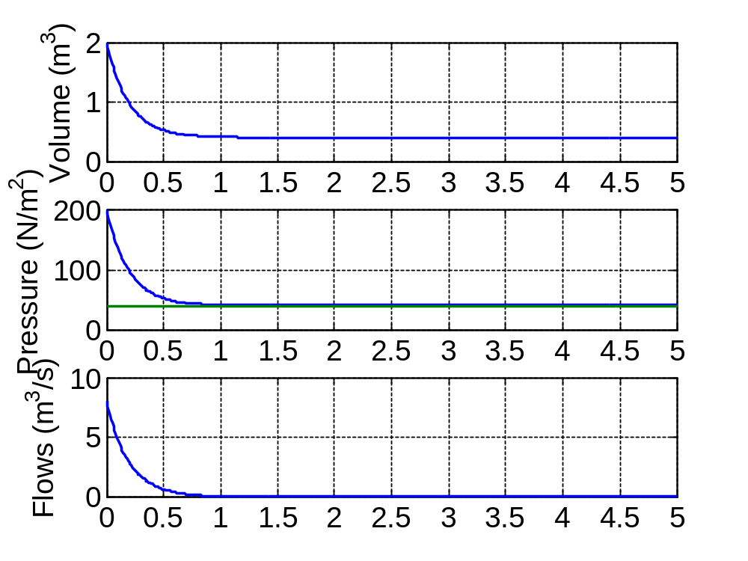
Results
2

Slide 31
Ventricle model results

